Slide 1
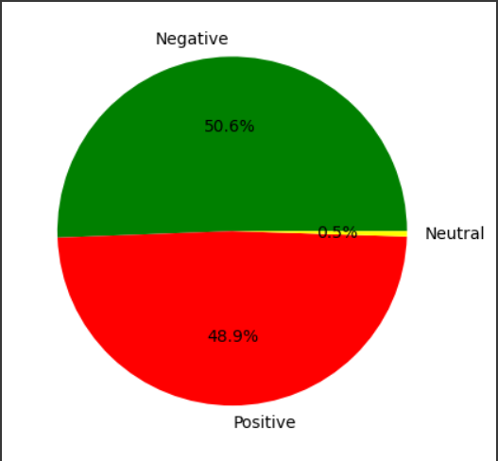
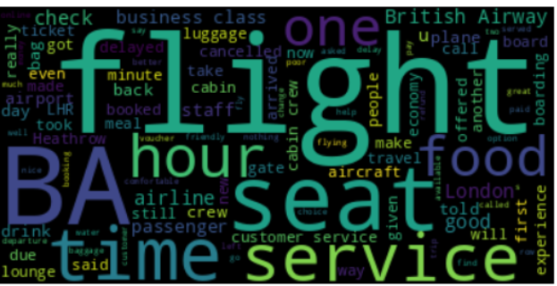
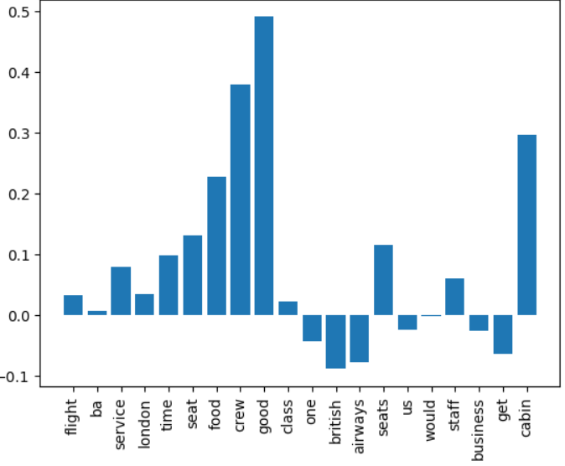
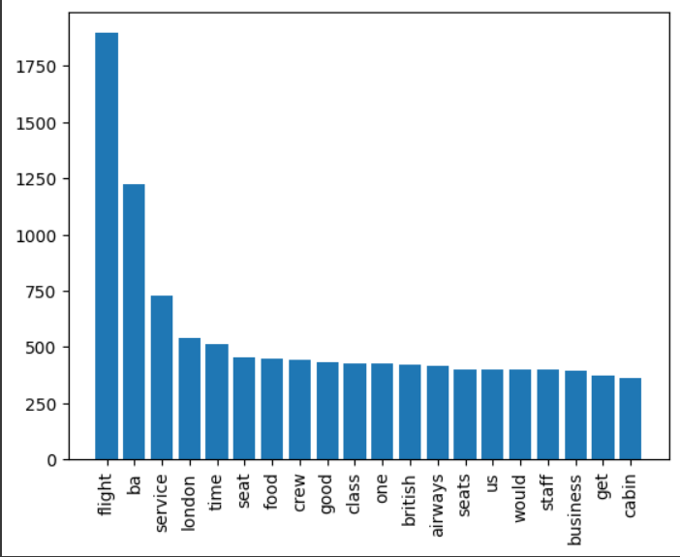
Sentiment Analysis from British Airways reviews from scraped data - Mathavan S G
Major of the reviews are negative,British Airways should focus on increasing their service and impression about their Brand
Conclusion-
Company should focus on seat,food,time,service and image of British Airways
Satisfaction level Graph
Most frequent words occurrence in the review

